Slide 1

Hexaware-GenAI
Unlocking Innovation-
Your Path to AI-Driven Excellence

Slide 2
Scope Of the project
Project Title: Chat Document Assistant using Snowflake Cortex
Project Objectives:
To develop a secure and efficient Retrieval Augmented Generation (RAG) application within Snowflake, leveraging Snowflake Cortex Search to reduce hallucinations in Large Language Models (LLMs) by grounding their responses with private datasets.
Deliverables:
A full-stack RAG application built entirely within Snowflake, eliminating the need for external integrations or infrastructure management.
A chat assistant capable of providing accurate responses by accessing relevant context from user manuals or other documents.
Streamlit UI providing chat interface for end users to access the knowledge base

Slide 3
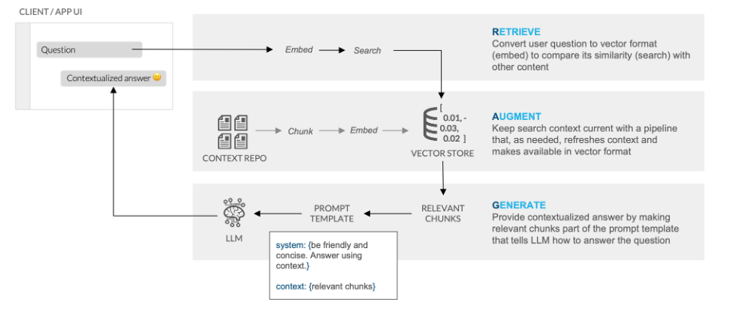
Design Diagram
The design leverages Snowflake's Cortex AI capabilities for text processing, categorization and establish chat conversations over documents.
Designed to process documents from Snowflake Stage, extract text chunks, embed, categorize and store them in Vector DB, and enable search functionality using RAG, LLMs along with Streamlit UI, all integrated within the Snowflake environment.

Slide 4
Design Description
Client/App UI: Interactive chat interface built with Streamlit, integrated within Snowflake for seamless user interaction.
Context Repository: Centralized repository with pipelines for text chunking and embedding into a vector store using Snowflake stages.
Cortex LLM Function(COMPLETE): Categorizes chunked data using Snowflake Cortex AI for better organization and filtered searches.
RAG (Retrieval-Augmented Generation): Combines retrieval from vector storage and LLMs to generate accurate, context-based responses.
Cortex Service Search: Semantic search powered by Snowflake Cortex AI to retrieve relevant information efficiently.
LLM Inference: Uses retrieved context and user queries to generate precise, reliable answers via conversational LLMs using the chosen available model.

Slide 5
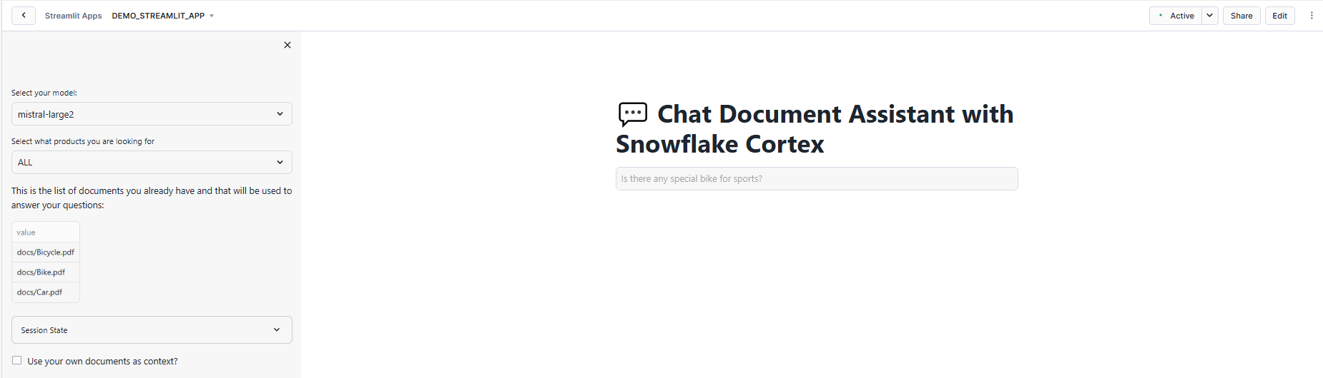
Deliverable
The Snowflake Streamlit UI provides an interactive chat interface that enables users to engage with stage documents, offering support for both RAG (Retrieval-Augmented Generation) and non-RAG modes. It ensures flexibility by allowing users to select their preferred LLM model for generating responses, catering to diverse use cases. Additionally, the platform empowers users to filter and choose document categories generated by LLMs, enhancing the precision and relevance of the information retrieved.

Slide 6

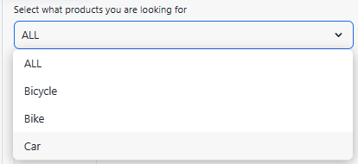


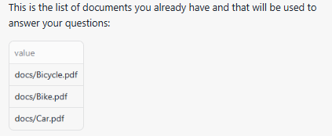
Test Cases
Testcase No | Testcase | Testcase Description | Evidence
TC1 | Text Extraction | Extract text chunks from uploaded PDF files
TC2 | Categorization | Categorize documents using LLMs
TC3 | Search Functionality | Perform searches to retrieve relevant text chunks
TC4 | Contextual Assistance | Generate accurate responses using retrieved context
TC5 | Document Management | List available documents and provide presigned URLs

Slide 7
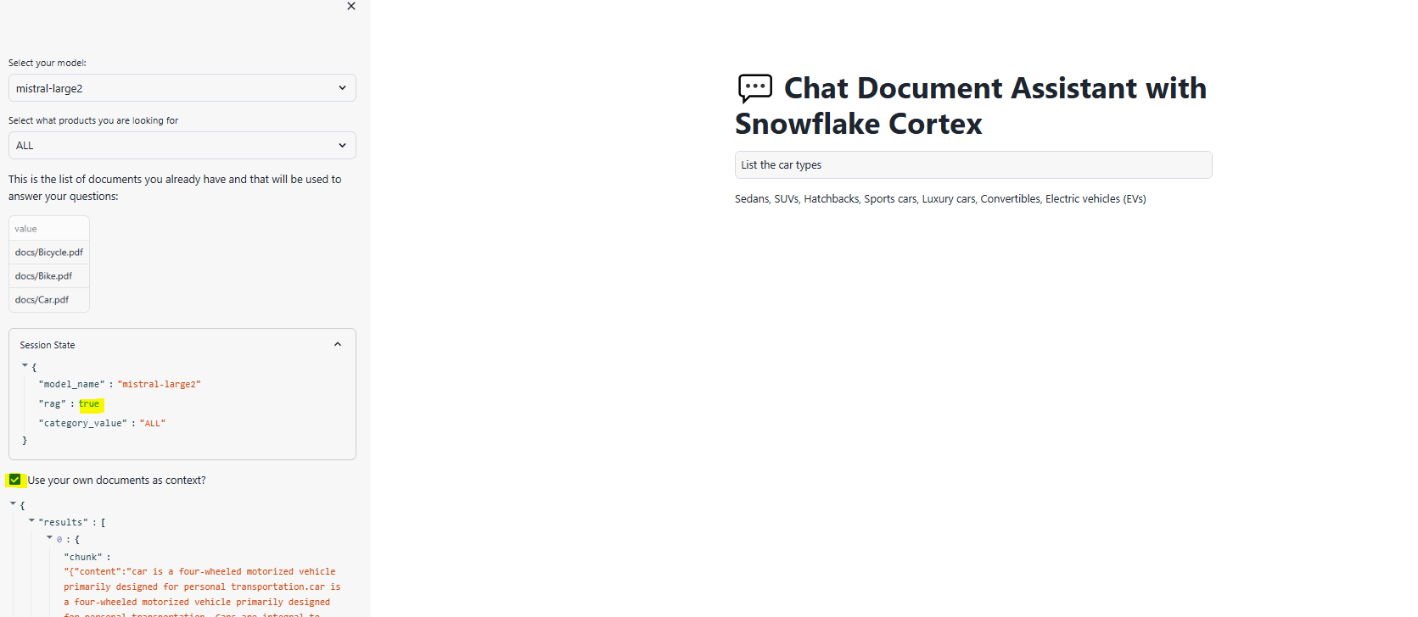
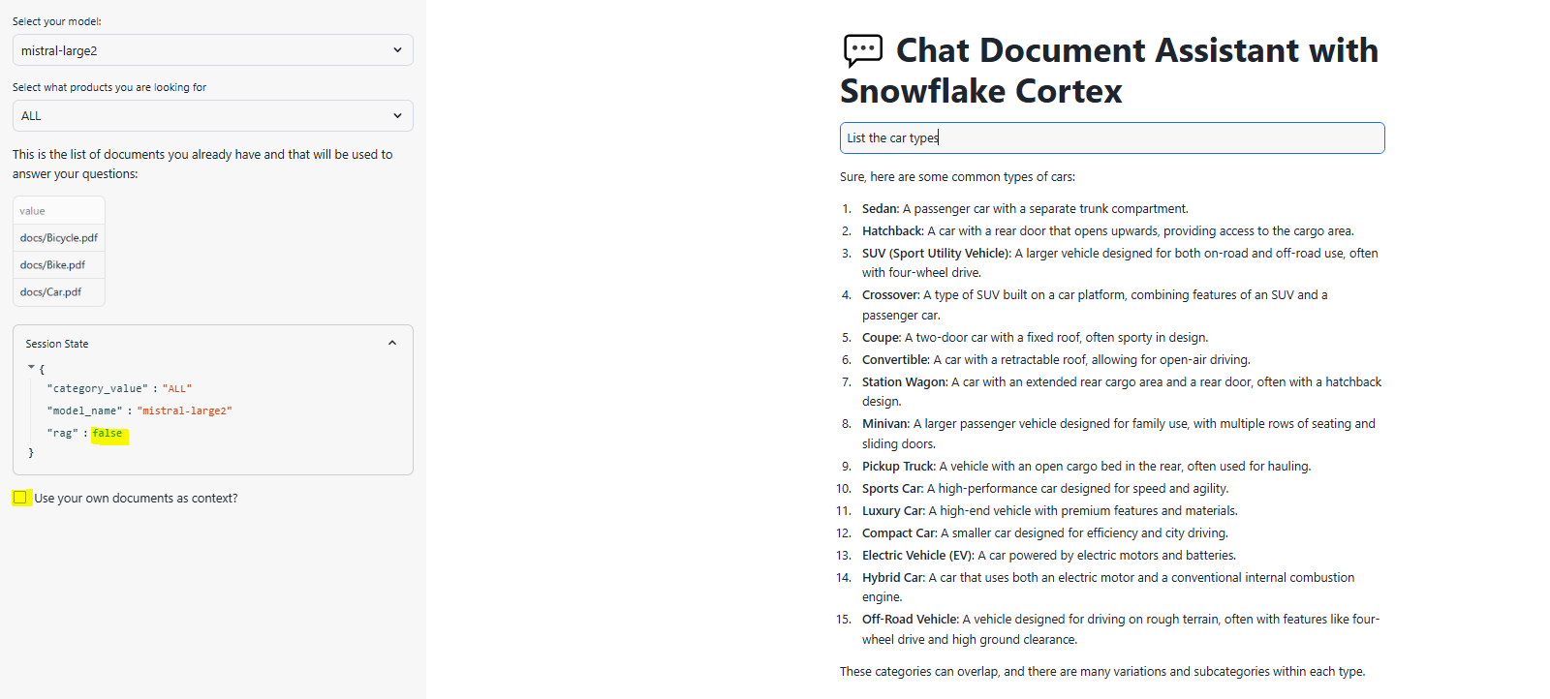
Test Cases
Testcase No | Testcase | Testcase Description | Evidence
TC6 | With RAG Integration | Combine retrieval and generation to produce contextual responses grounded in document data
TC7 | Without RAG Integration | Response from LLM and not the document data

Slide 8


Test Cases
Testcase No | Testcase | Testcase Description | Evidence
TC8 | Moderation Check | Avoiding Harmful responses using LLMs
TC9 | Out of document ask | Ignore out of content questions

Slide 9
Tools and Code Details
All the tools used for this project are Snowflake Integrated tools:
Snowflake account in a cloud region where Snowflake Cortex LLM functions are supported.
Snowflake LLM Function - COMPLETE
Snowflake CORTEX SEARCH SERVICE
Streamlit App
Python Libraries
Sample PDF documents to load into stage for the chat conversations
Car.pdf
Bike.pdf
Bicycle.pdf
Code Repository:

Slide 10

Thank you

